Slide 1
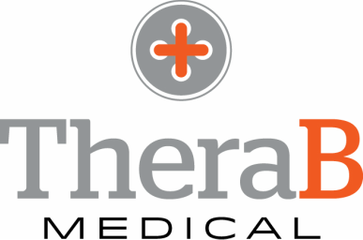
Alexa Jones CEO & Co-founder
alexa.jones@therabmedical.com| www.therabmedical.com
Notes:
Hello, My name is Alexa Jones and I am the CEO of TheraB Medical

Slide 2
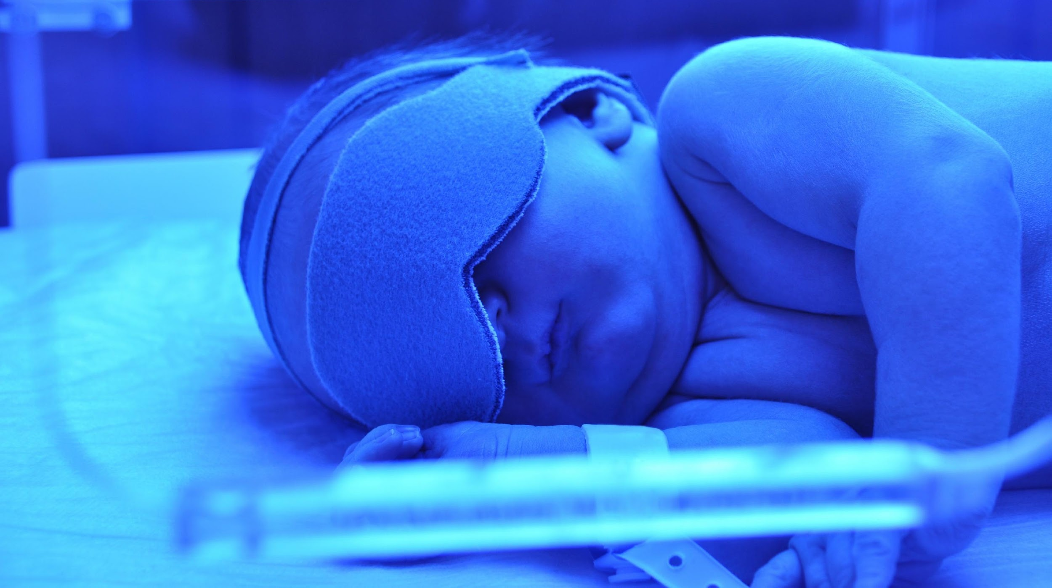
The Problem: Jaundice
Notes:
Jaundice is a condition that affects nearly 2.5 M babies in the US each year. It’s caused by a buildup of a blood molecule called Bilirubin, and can cause serious brain damage if not treated within the first few days of life.
Jaundice is treated with phototherapy, where blue light is exposed directly to the infant’s skin. However, there has been little innovation in this market in years. Clinicians, nurses, and parents are not satisfied with the treatment options.

Slide 3
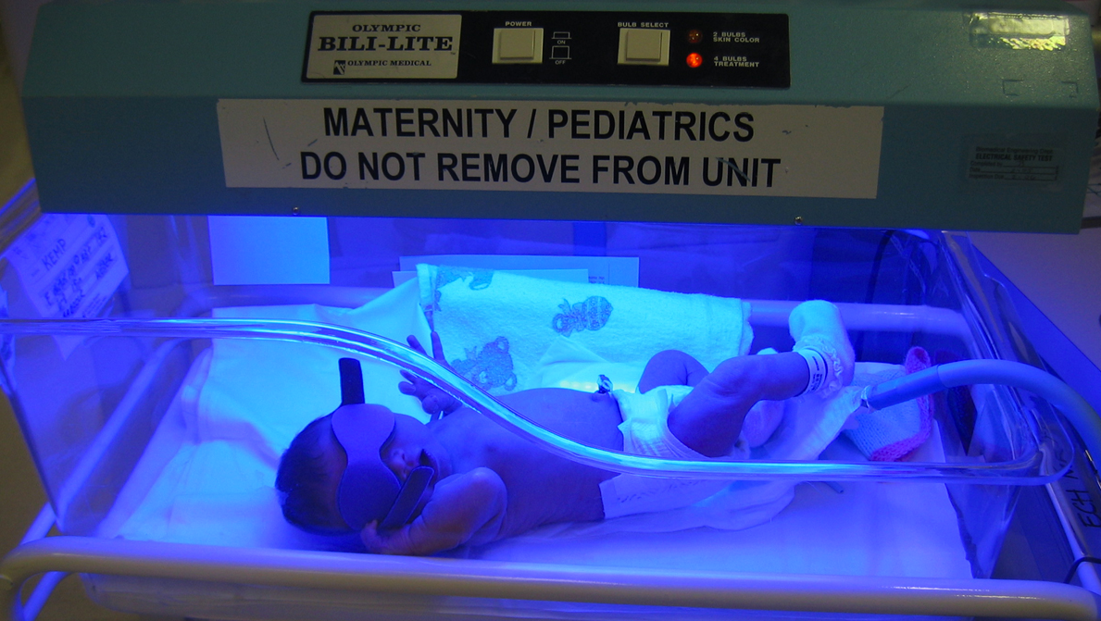
Current Treatments
TheraB Medical
Notes:
Current treatments are cumbersome and not portable, cause stress and separation between mother and baby, and only cover one side of the baby’s body.
In fact, it’s common practice for nurses to improvise with what they have- and use 2, sometimes 3 devices at a time to try to achieve the max skin exposure. It’s nearly impossible to hold, bond with, or breastfeed your baby at all during the 3-7 days of treatment.

Slide 4
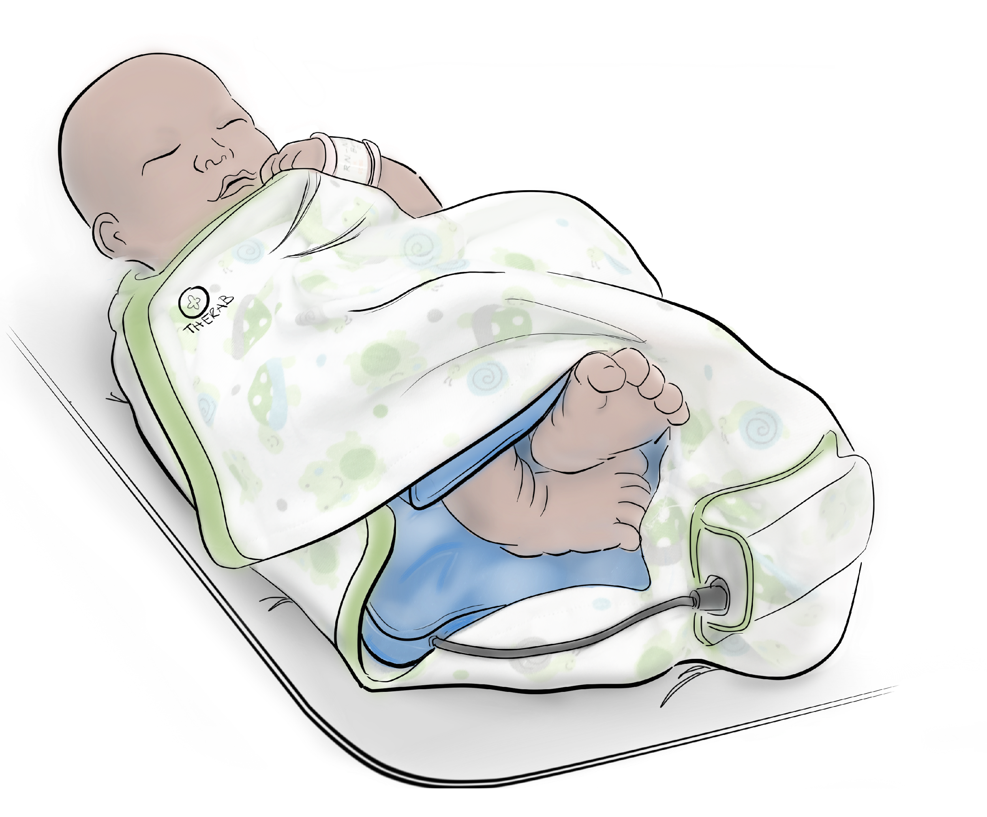
SnugLit
The wearable treatment for infant jaundice.
Notes:
SnugLit is a solution to these problems. SnugLit is a wearable garment that allows newborns to be held, comforted, and breastfed during treatment—while covering twice the surface area of a standard device. We developed SnugLit with the input of over 200 clinicians and nurses in hospitals throughout Michigan.

Slide 5
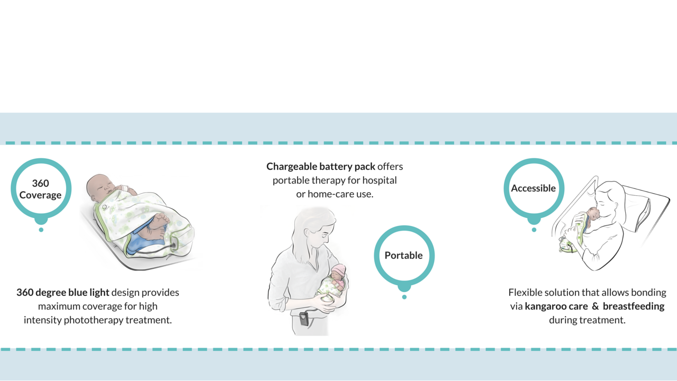
What Makes SnugLit Different?
TheraB Medical
Notes:
Unlike current solutions, SnugLit provides blue light coverage on all sides of the baby. This leads to more effective and faster treatment time. The device is wearable- and is secured to the child with an included swaddle. Treatment can easily take place in the patient’s room- not a nursery.
SnugLit is battery powered and free of all tubes, cords, and overhead lighting. This means SnugLit is portable and can be easily used both in the hospital and home-care settings.
Also, SnugLit allows for easier bonding and breastfeeding during the crucial first days of a child’s life.
We’ve completed 2 working prototypes and have identified a manufacturing partner. We will complete product development and testing by the end of 2017. SnugLit is a class II device and requires FDA submission, but does not require clinical trials. We have filed 1 provisional patent and have another 3 in process.

Slide 6
Market Analysis
Total Available Market
4,000 hospitals in US
Avg. 12 units/hospital
$168 million
Served Available Market
Initial market= 600 hospitals in Midwest
$25.2 million
Target Market
Initial adoption rate of product= 40%
$10.1 million
TAM
$168 million
SAM
$25.2 million
Target
$10.1 million
TheraB Medical
Notes:
Our initial market is the 4,000 hospitals in the US with birthing units. Considering each hospital has approximately 12 devices, that’s a $168M market. We plan to first target the 600 hospitals in the Midwest. Assuming a 40% adoption rate, or 4 units per hospital- our target market size is $10M, which is about our projected 2020 revenue.

Slide 7

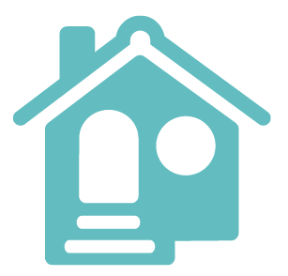
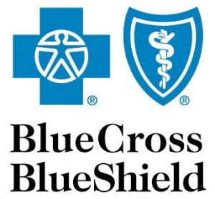

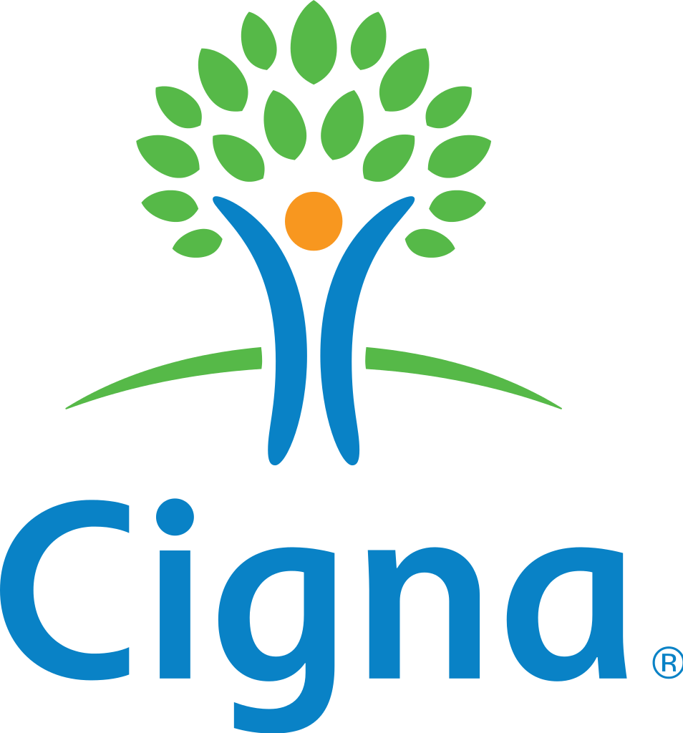

Go To Market Strategy
Durable Medical Equipment
(Home care)
Hospitals
[Distributor]
[Distributor]
[Already existing insurance code]
TheraB Medical
Notes:
We will go to market through 2 channels- through hospitals and home care suppliers. We have formed relationships with 6 hospitals in Michigan who will be our first adopters. We will incorporate distribution partners by 2019. Our product is reimbursable through existing insurance codes.

Slide 8


Launch Plan
Initial Market:
4,000+ U.S. hospitals
Secondary Market:
10,000+ home care suppliers
Tertiary Market:
Global market outside of U.S.
TheraB Medical
Notes:
After gaining traction in the US hospital and home care markets, we will expand our sales to other markets worldwide, including Europe, Brazil and Mexico.

Slide 9
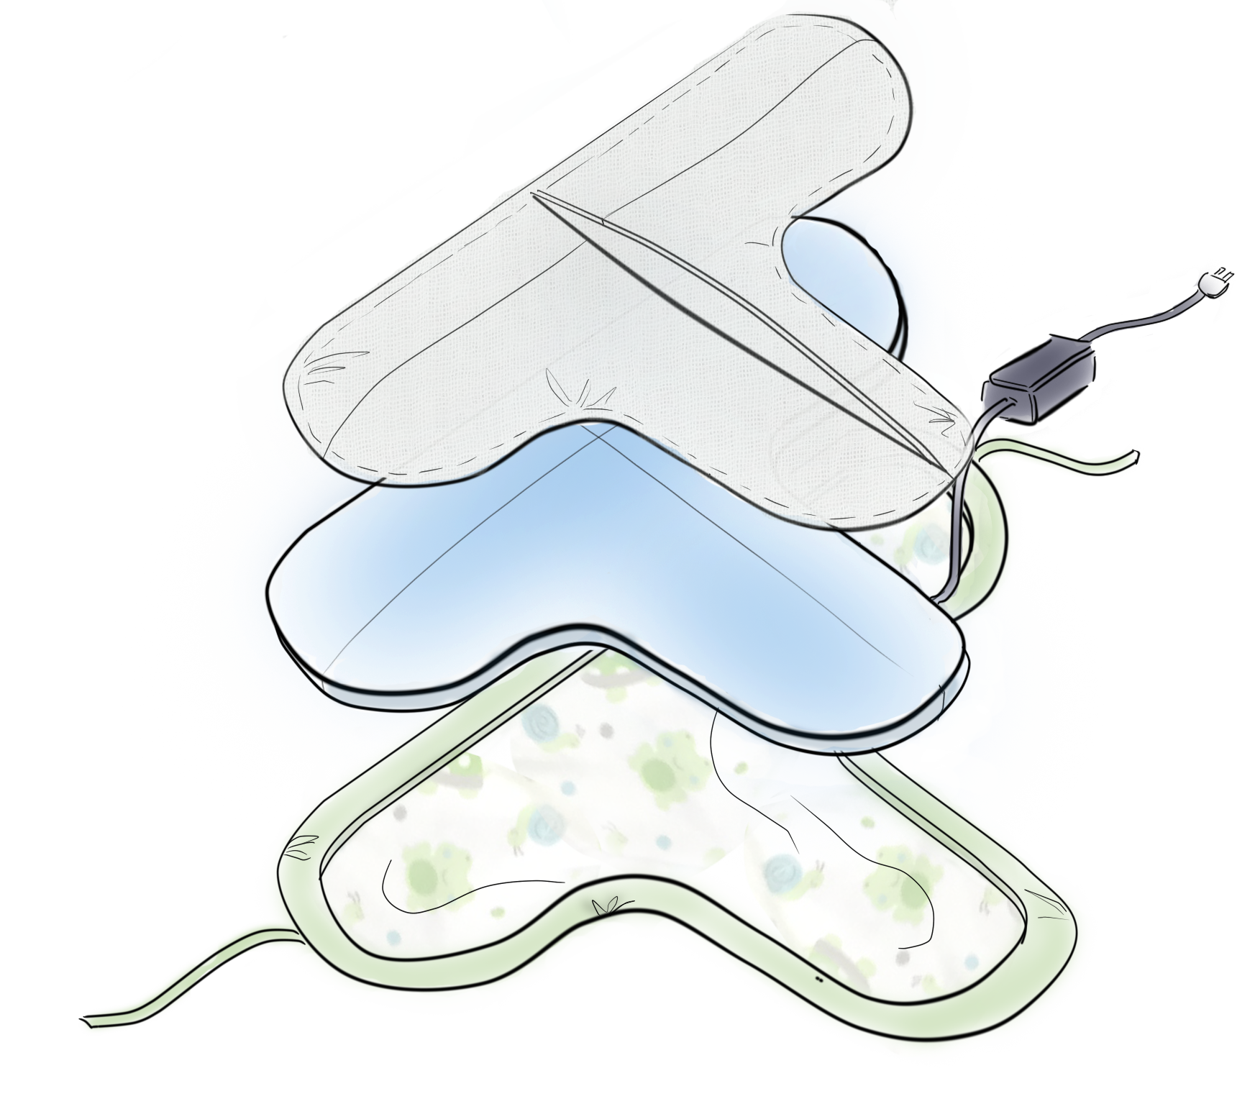
Revenue Model
Reusable Light
$3,500/unit
10-15 units/hospital
Disposable Swaddle
$10/swaddle
5-10 swaddles/baby
TheraB Medical
Notes:
SnugLit creates revenue through a reusable/disposable model. The light portion of the device is reusable between infants and retails for $3,500. An average hospital will hold 10-15 in inventory.
The disposable swaddle portion is sold in bulk and is used to provide a clean/dry interface with the child. The disposable is changed at least once daily throughout the 3-7 days of treatment and is sold for $10 per disposable.

Slide 10
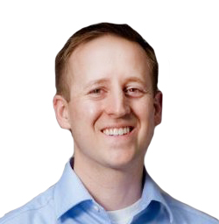
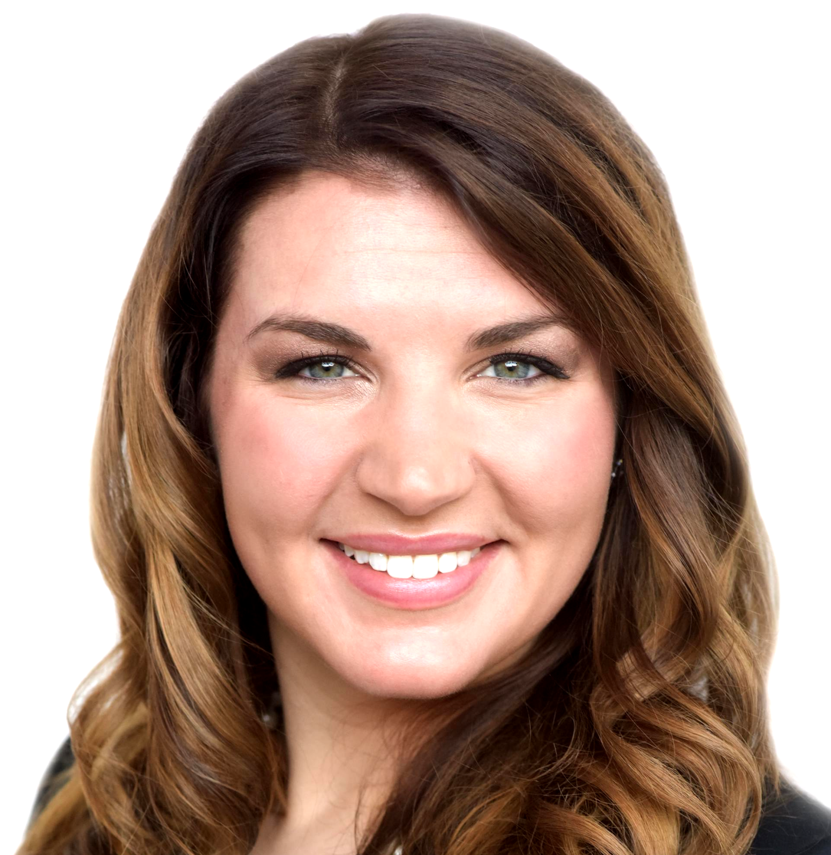
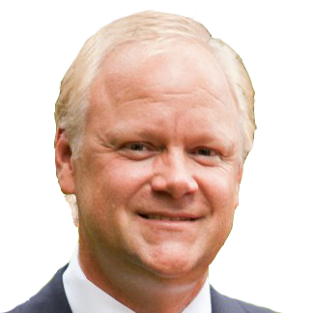

Meet the Team
Alexa Jones
CEO & Co-Founder
BS BioEngineering, MSU
Analyst at Goldman Sachs
R&D and Engineering at J&J DePuy Orthopedics
Ryan Jankovic
Sales/Marketing Advisor
Serial entrepreneur
Experience launching med devices
13+ yrs in med device sales/marketing at Stryker
John Dahler
CFO
30 + years as senior financial executive
Financial executive for several large companies (KPMG, Pillsbury)
Dr. Said Omar
Clinical Advisor
Neonatal-Perinatal Medicine Specialist
Director of the NICU at Sparrow Hospital
Professor at MSU College of Human Medicine
TheraB Medical
Notes:
We have a well- rounded team with experience in engineering, medical device sales, finance, and neonatology. I am the current CEO and one of the initial inventors of the product.

Slide 11



Upcoming Milestones
Raise $500,000 seed round by Q3 2017
Complete product development and testing, and submit to FDA by Q4 2017
Product Launch by Q1 2018
TheraB Medical
Notes:
We’ve had great traction and currently have 3 investors. We’re currently raising a $500k seed round in order to complete product development and testing, submit for FDA approval and manufacture initial inventory. We plan to get through the FDA process quickly, with our straight forward testing requirements and existing predicate. We will launch in our first MI hospitals by the end of Q1 of next year.

